Slide 1

PLAYING CARDS DETECTION AND COUNTING
A COMPUTER VISION PROJECT
NOAH JAUCHMANN – 00817016
MUHAMMAD ARSALAN - 12303218
ALEXANDER GLASER - 00819454
HARSH GURAWALIYA - 22109730

Slide 2
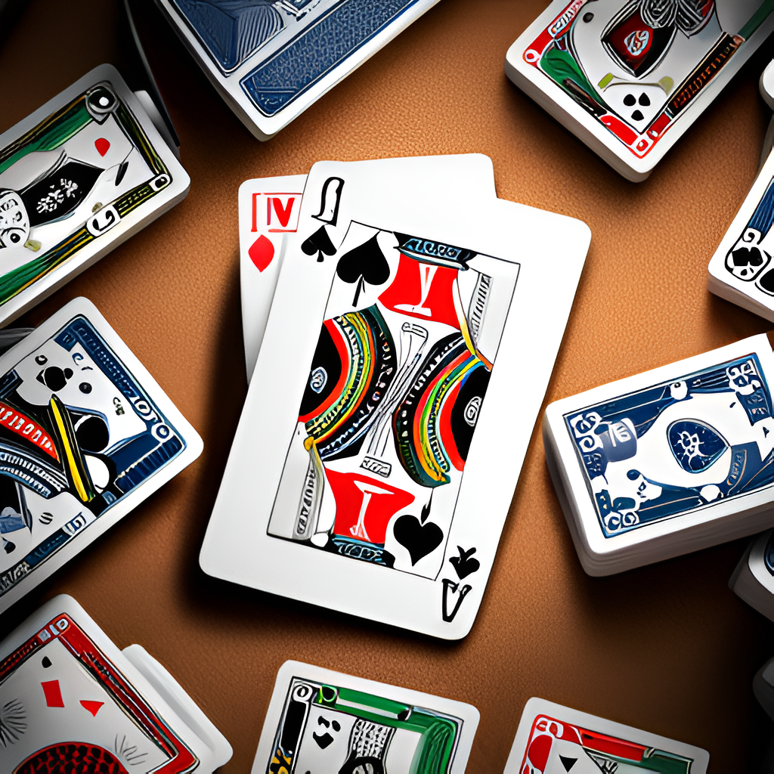
INTRODUCTION
Accurate playing card detection when shown to a webcam.
Keeping the count of detected and remaining cards from a standard deck of 52.
Marking out the cards already drawn
Implementation of object detection and neural networks using YOLOv5.

Slide 3
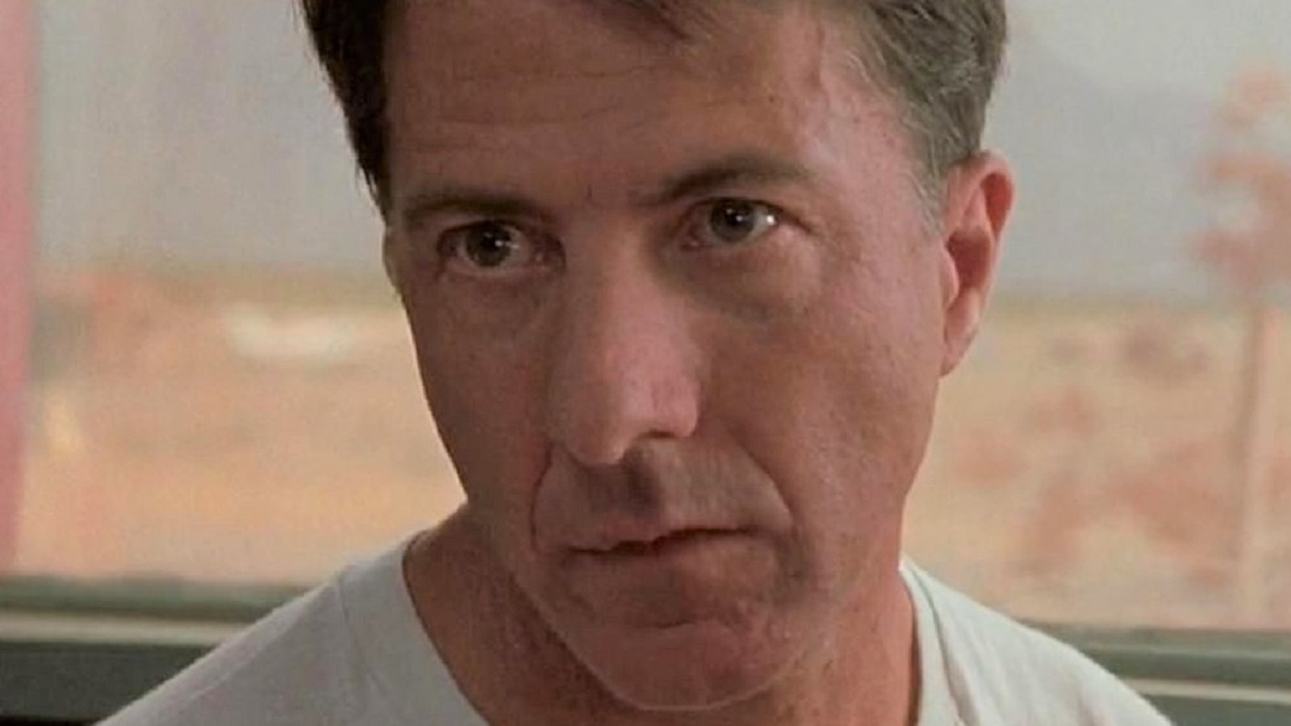
MOTIVATION
To mimic Raymond from Rain Man [movie reference]
Applications in:
Casino surveillance
Training card players
Game Analysis and Research
Automated Card games

Slide 4
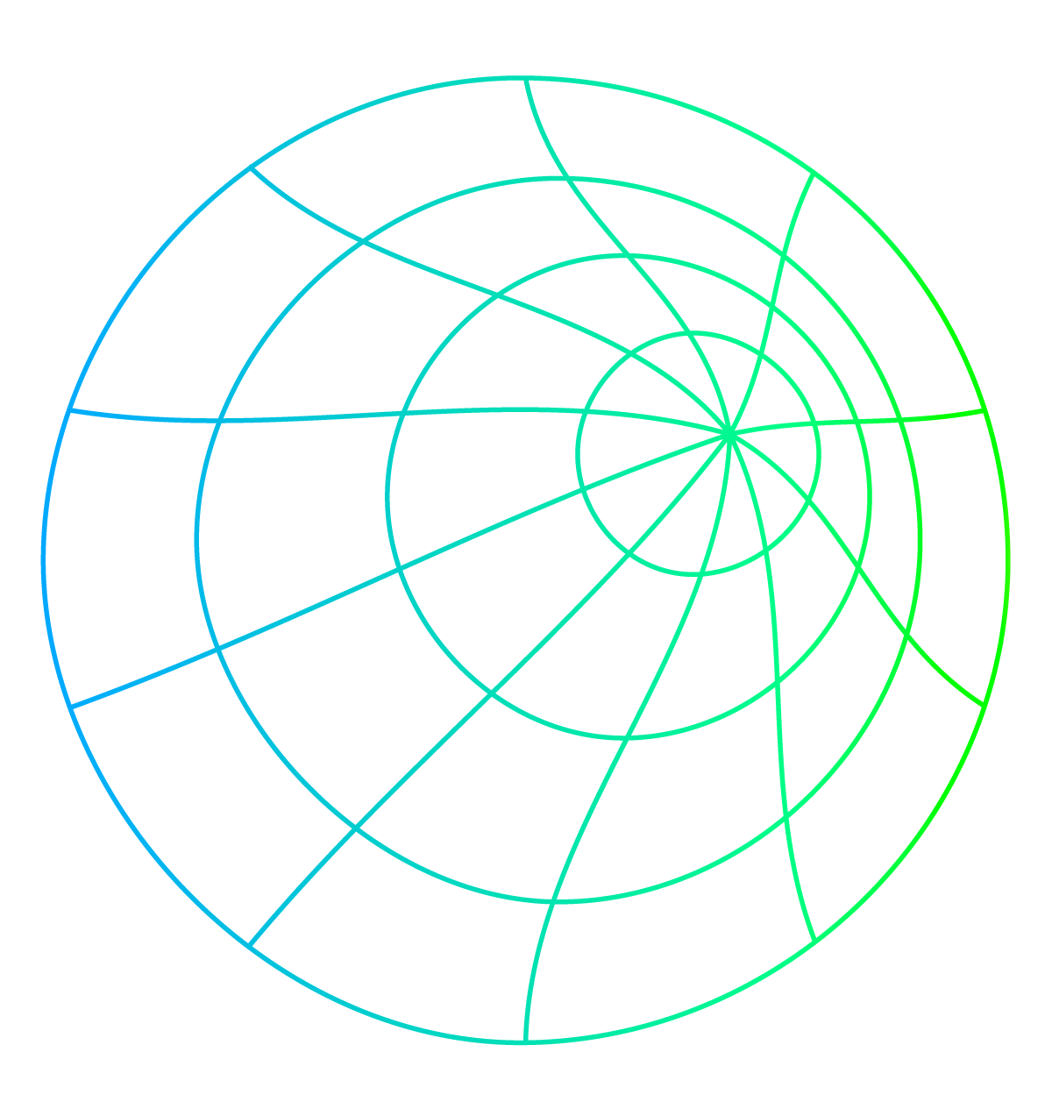
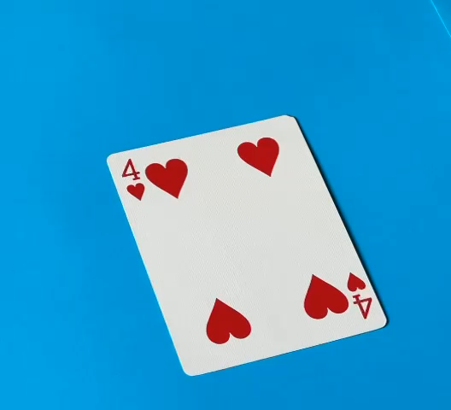
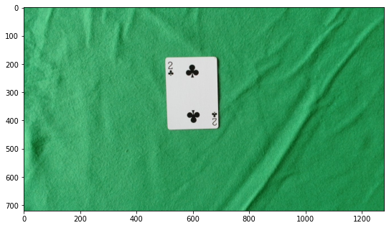
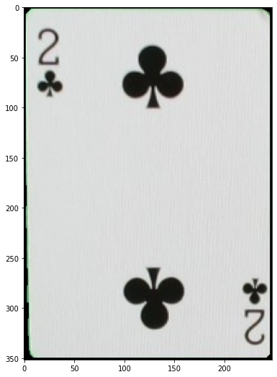
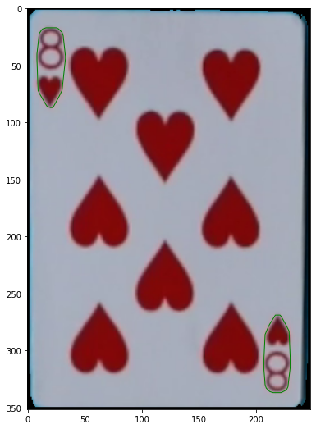
METHODOLOGY
DATASET PREPARATION
Recorded 1 video per card with different lightings and perspectives.
Extracted cards from videos using OpenCV
video capture methodology.
Delimited negative spaces around by formation of convex hulls.
Around 40-50 images were extracted for each card with convex hulls bounding rank and suit portion to be trained.

Slide 5
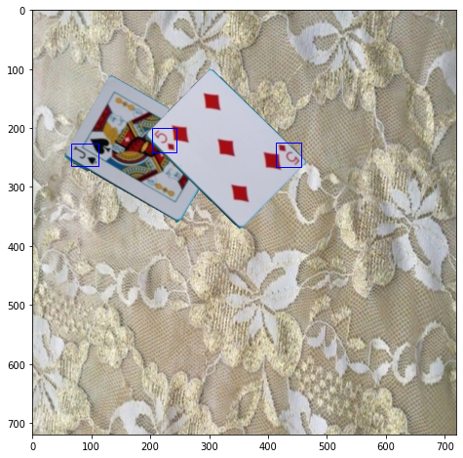
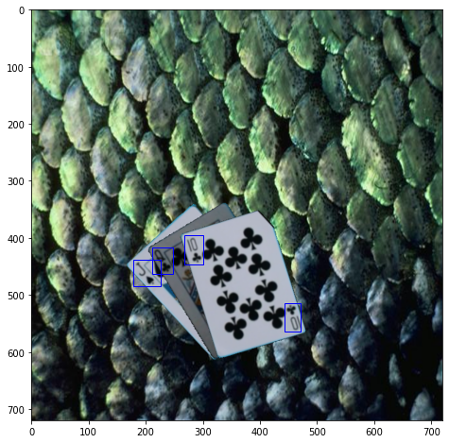
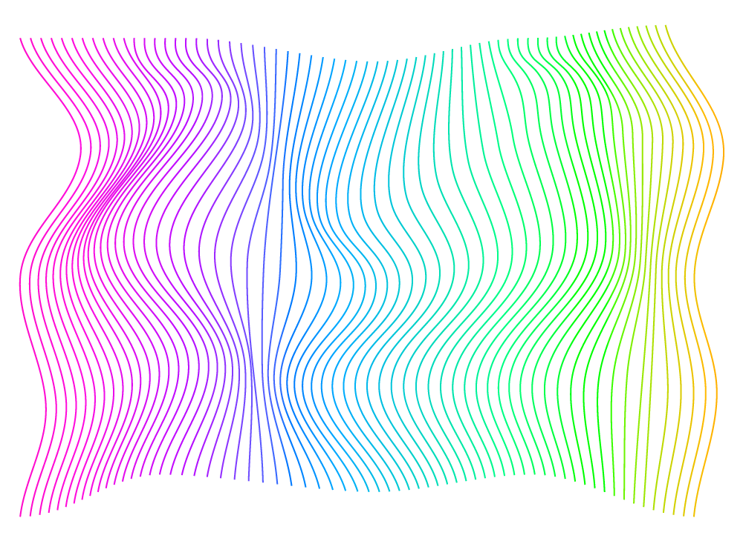
METHODOLOGY
DATASET PREPARATION
Scenes created using image augmentation.
Each scene has multiple cards randomly scaled, rotated translated and overlapped.
Describable Textures Dataset (DTD) was used for random background images behind each scene.
Created 20,000 images for dataset with random backgrounds and cards.

Slide 6
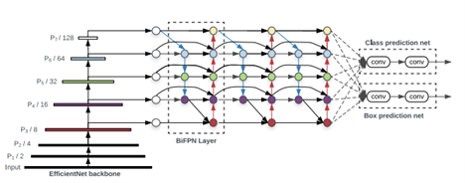
METHODOLOGY
TRAINING
Trained using state of the art object detection algorithm YOLOv5
High speed and efficient object detection with CSPDarknet53 backbone network
Easier and flexible with user-friendly implementation and active community
Fine-tuning of hyperparameters i.e., batch size, learning rates.
2 hours of training for 16 epochs.

Slide 7
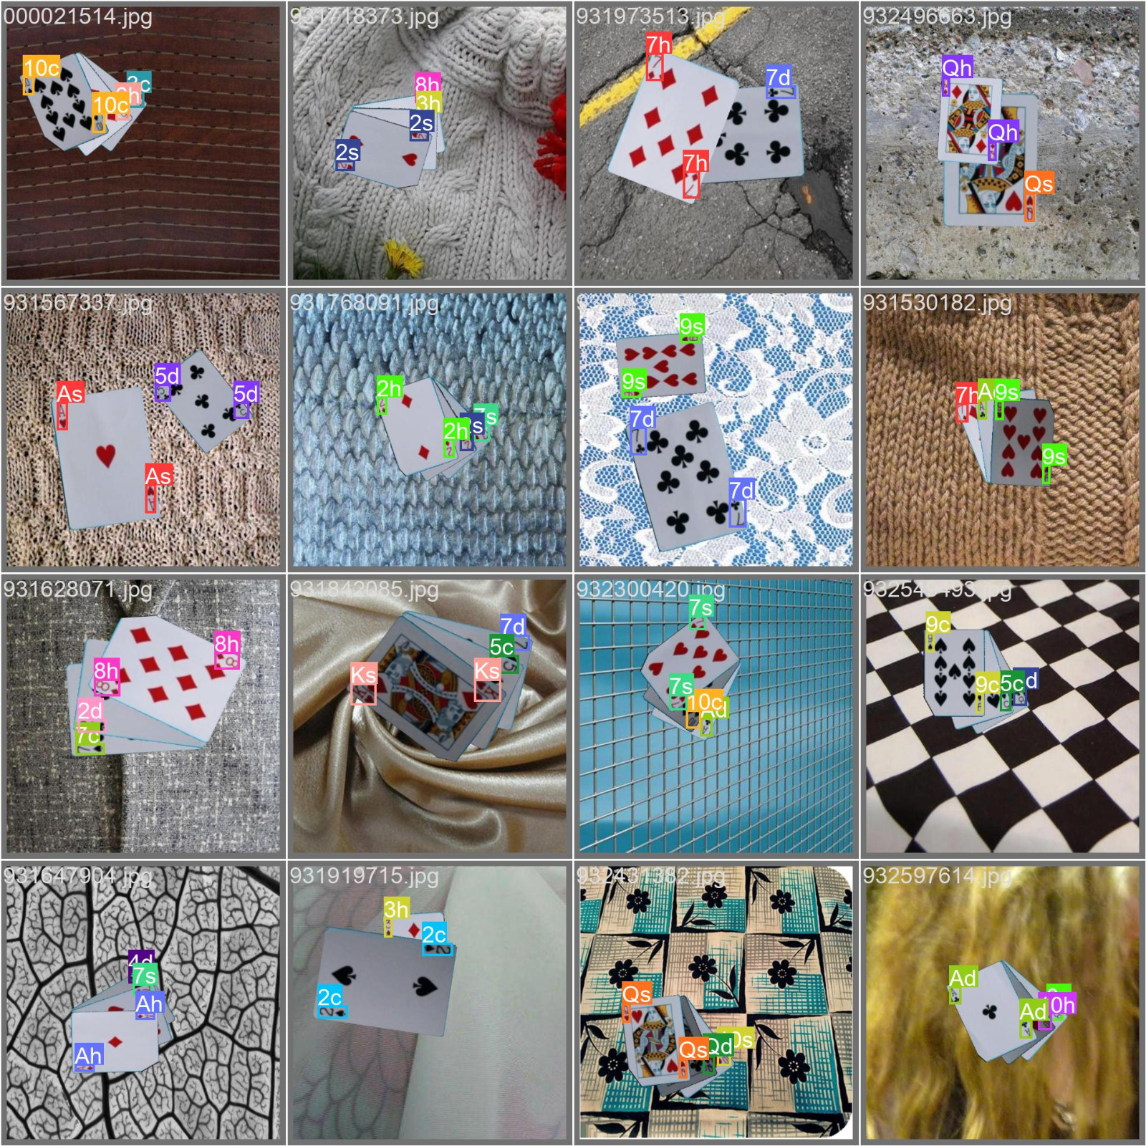
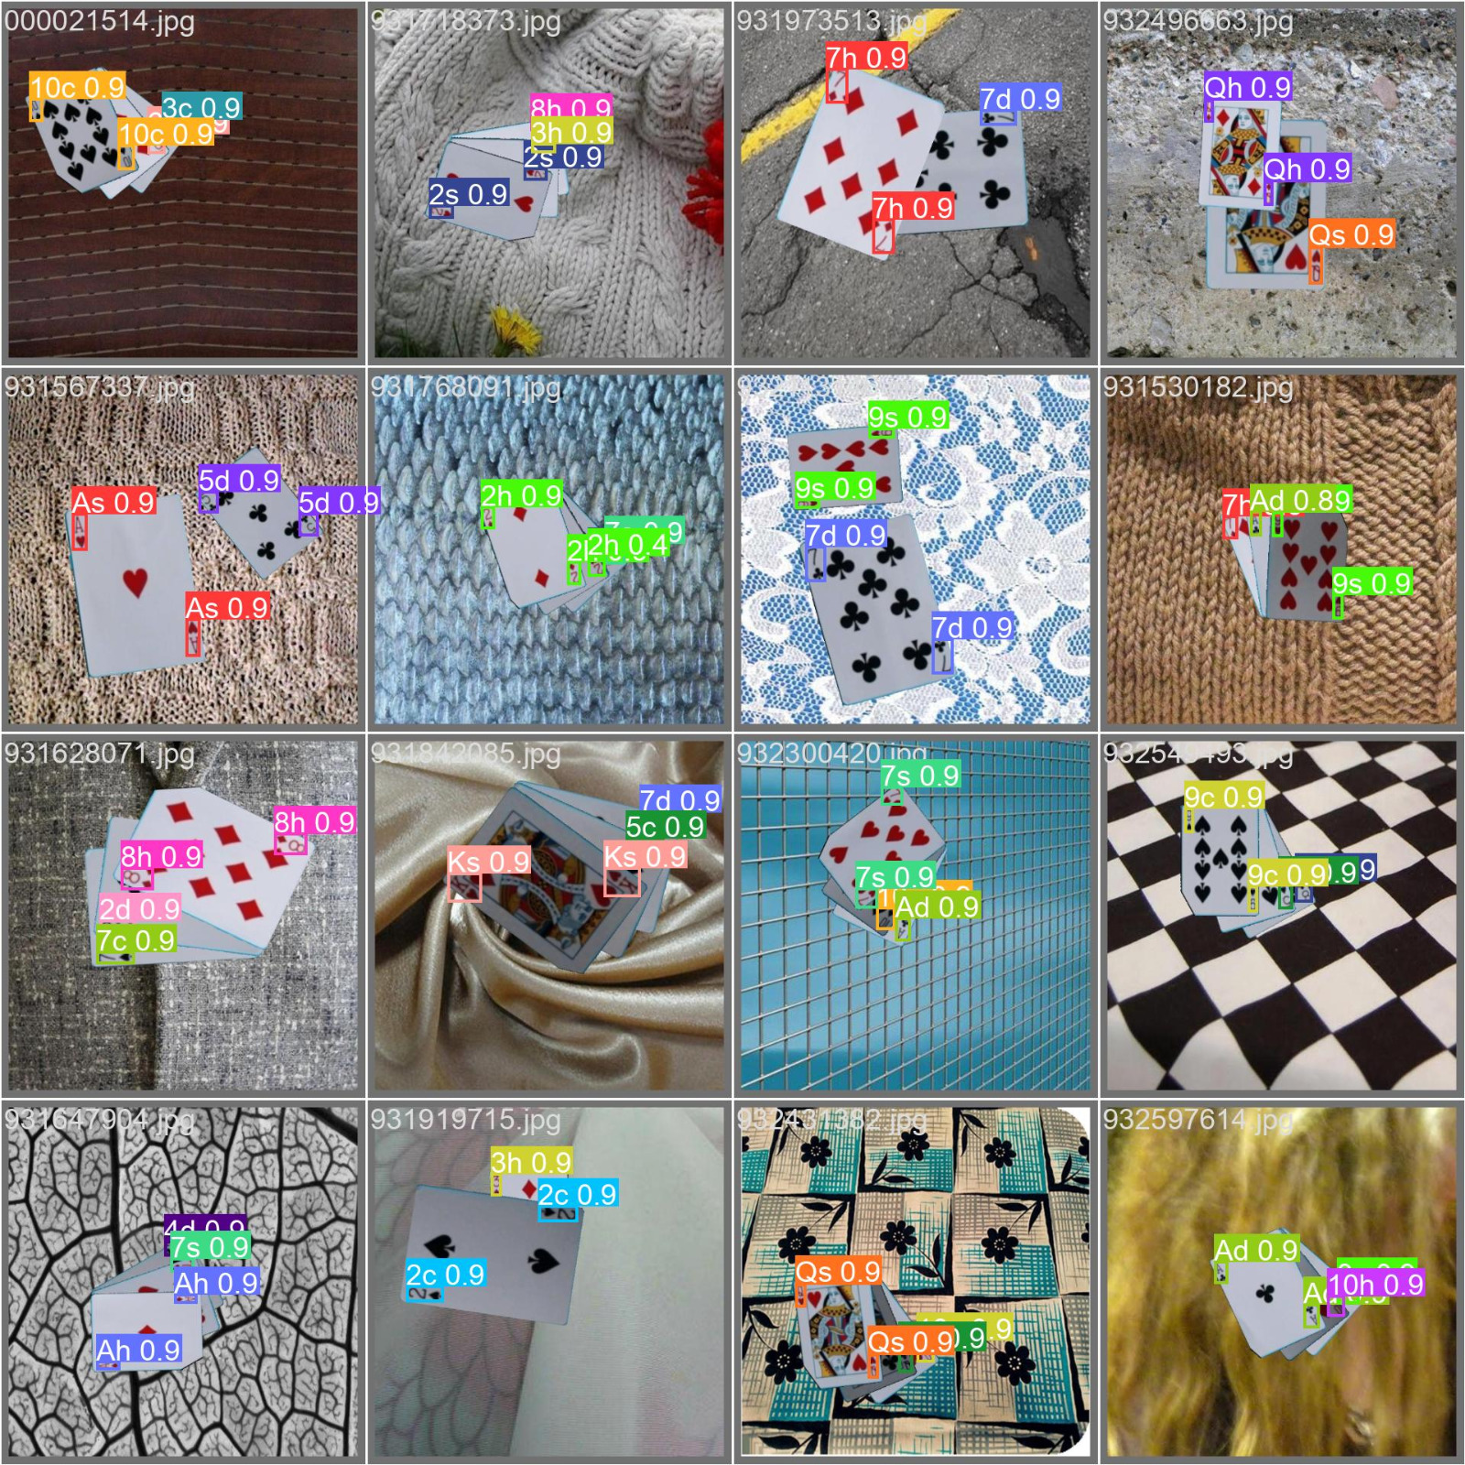
METHODOLOGY
VALIDATION

Slide 8
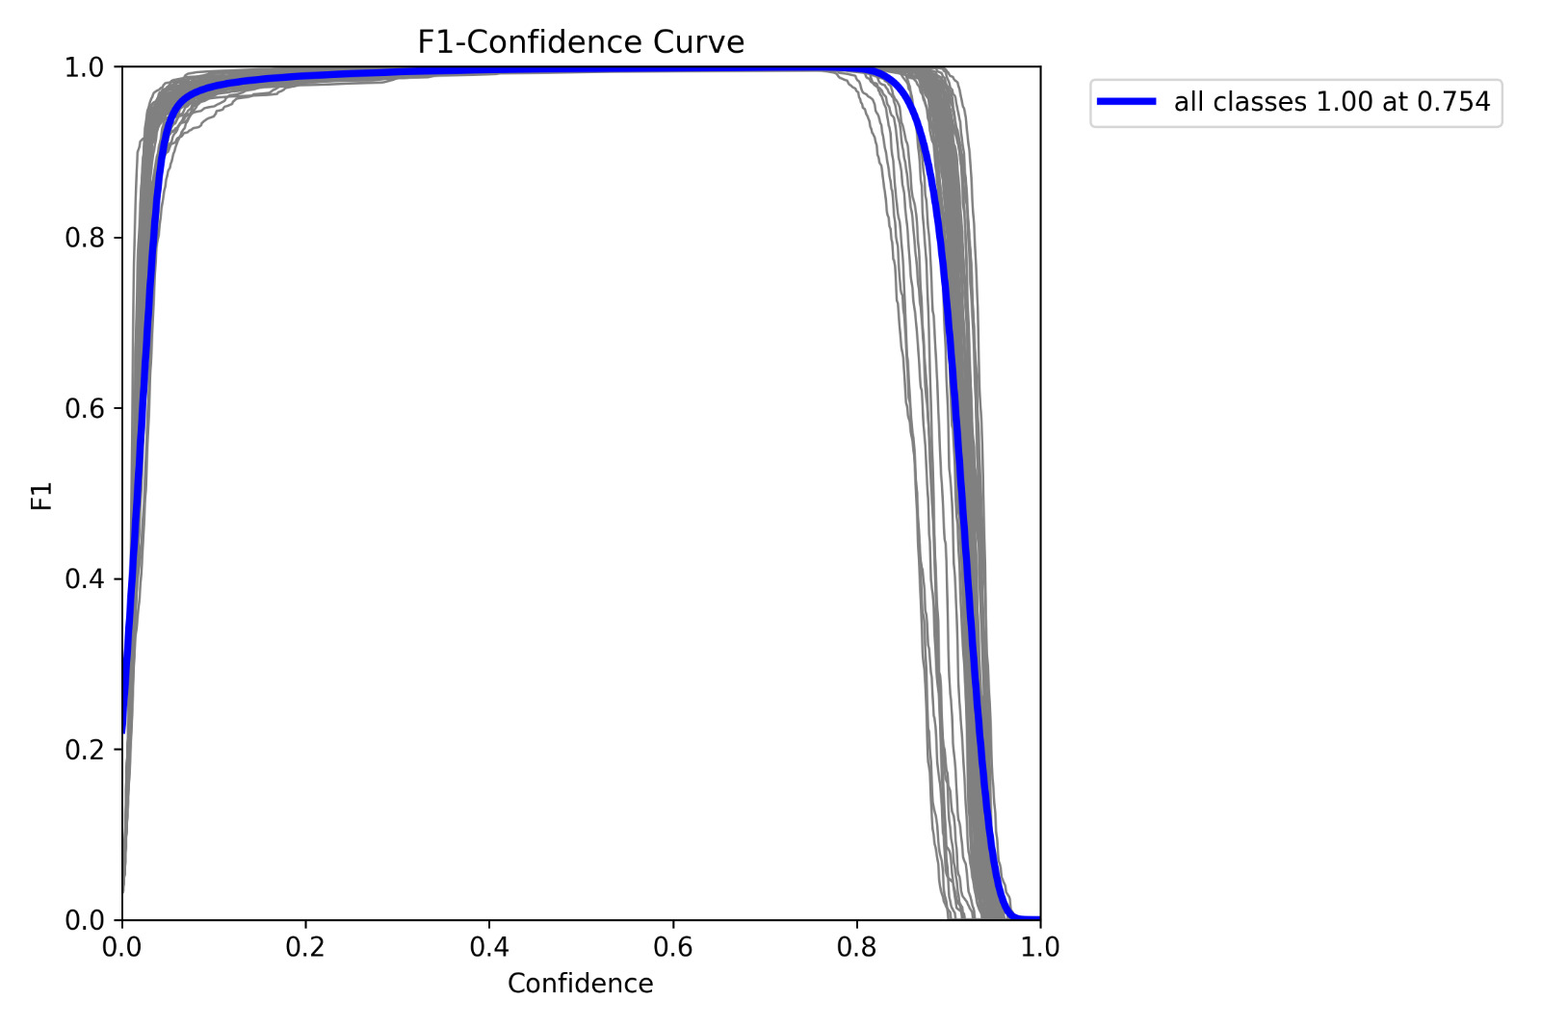
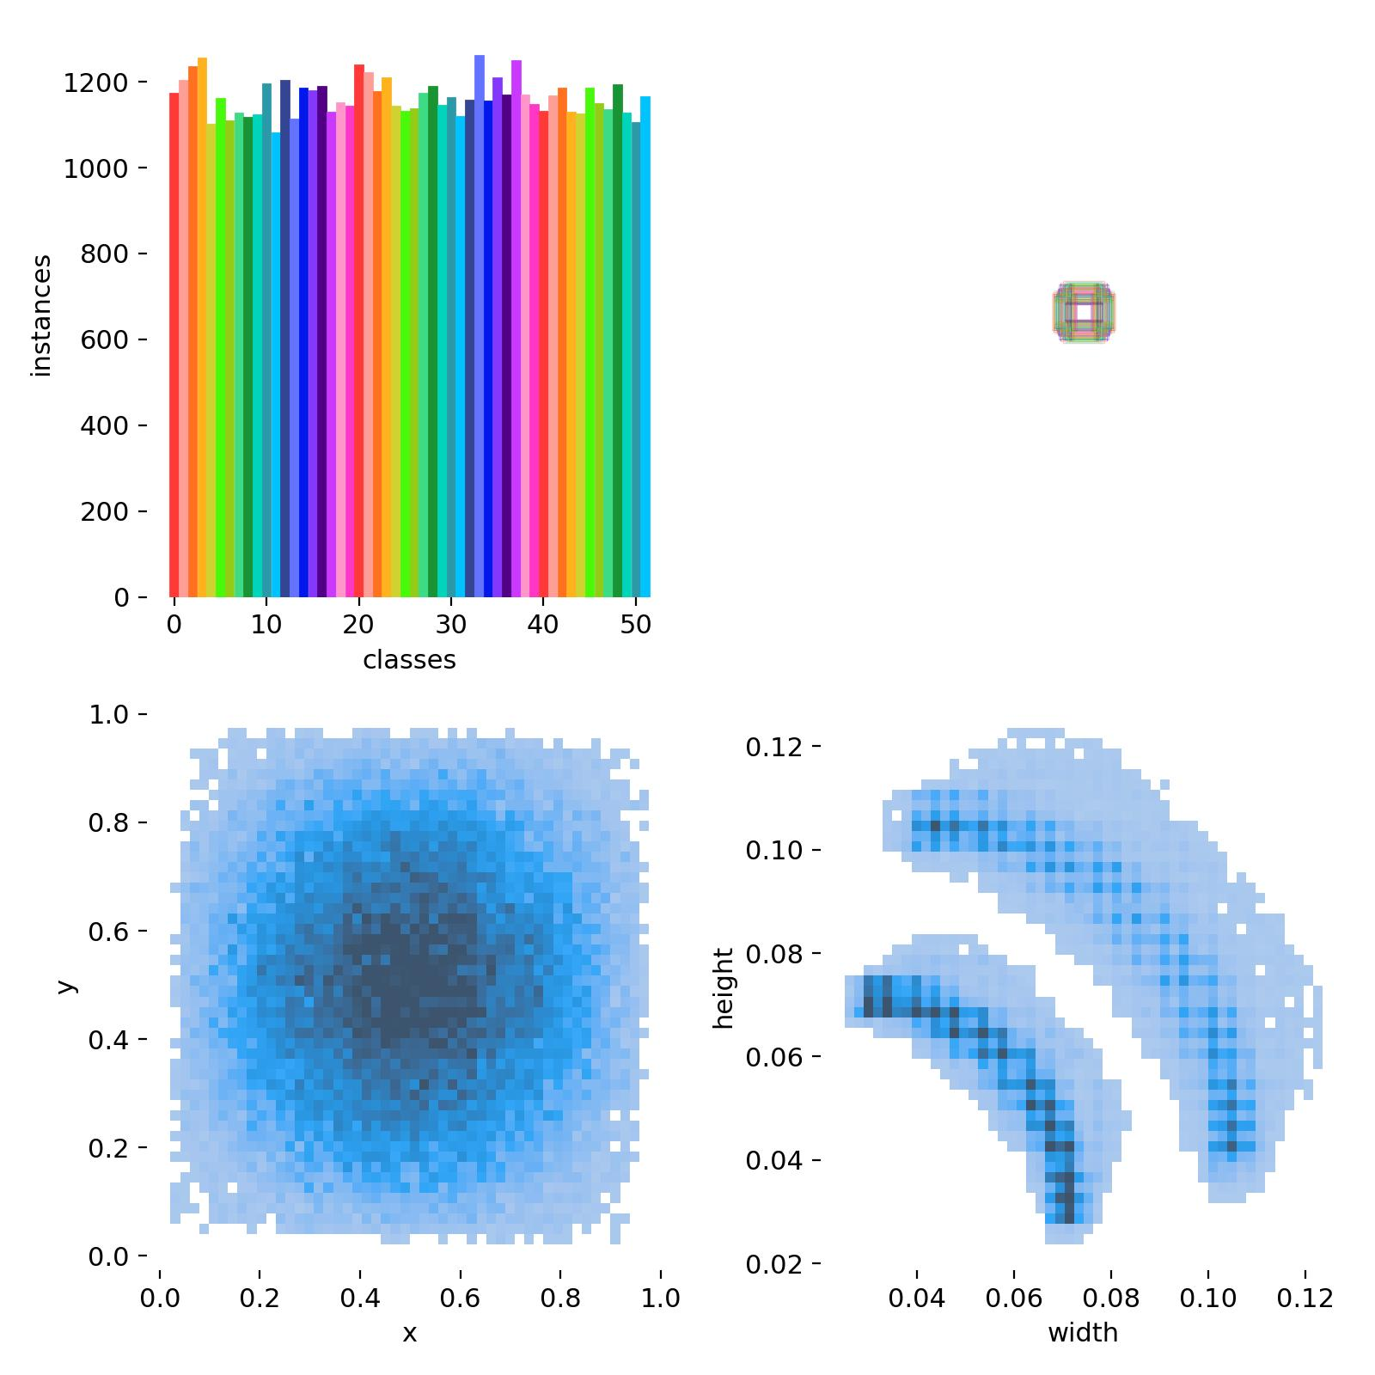
METHODOLOGY
RESULTS

Slide 9
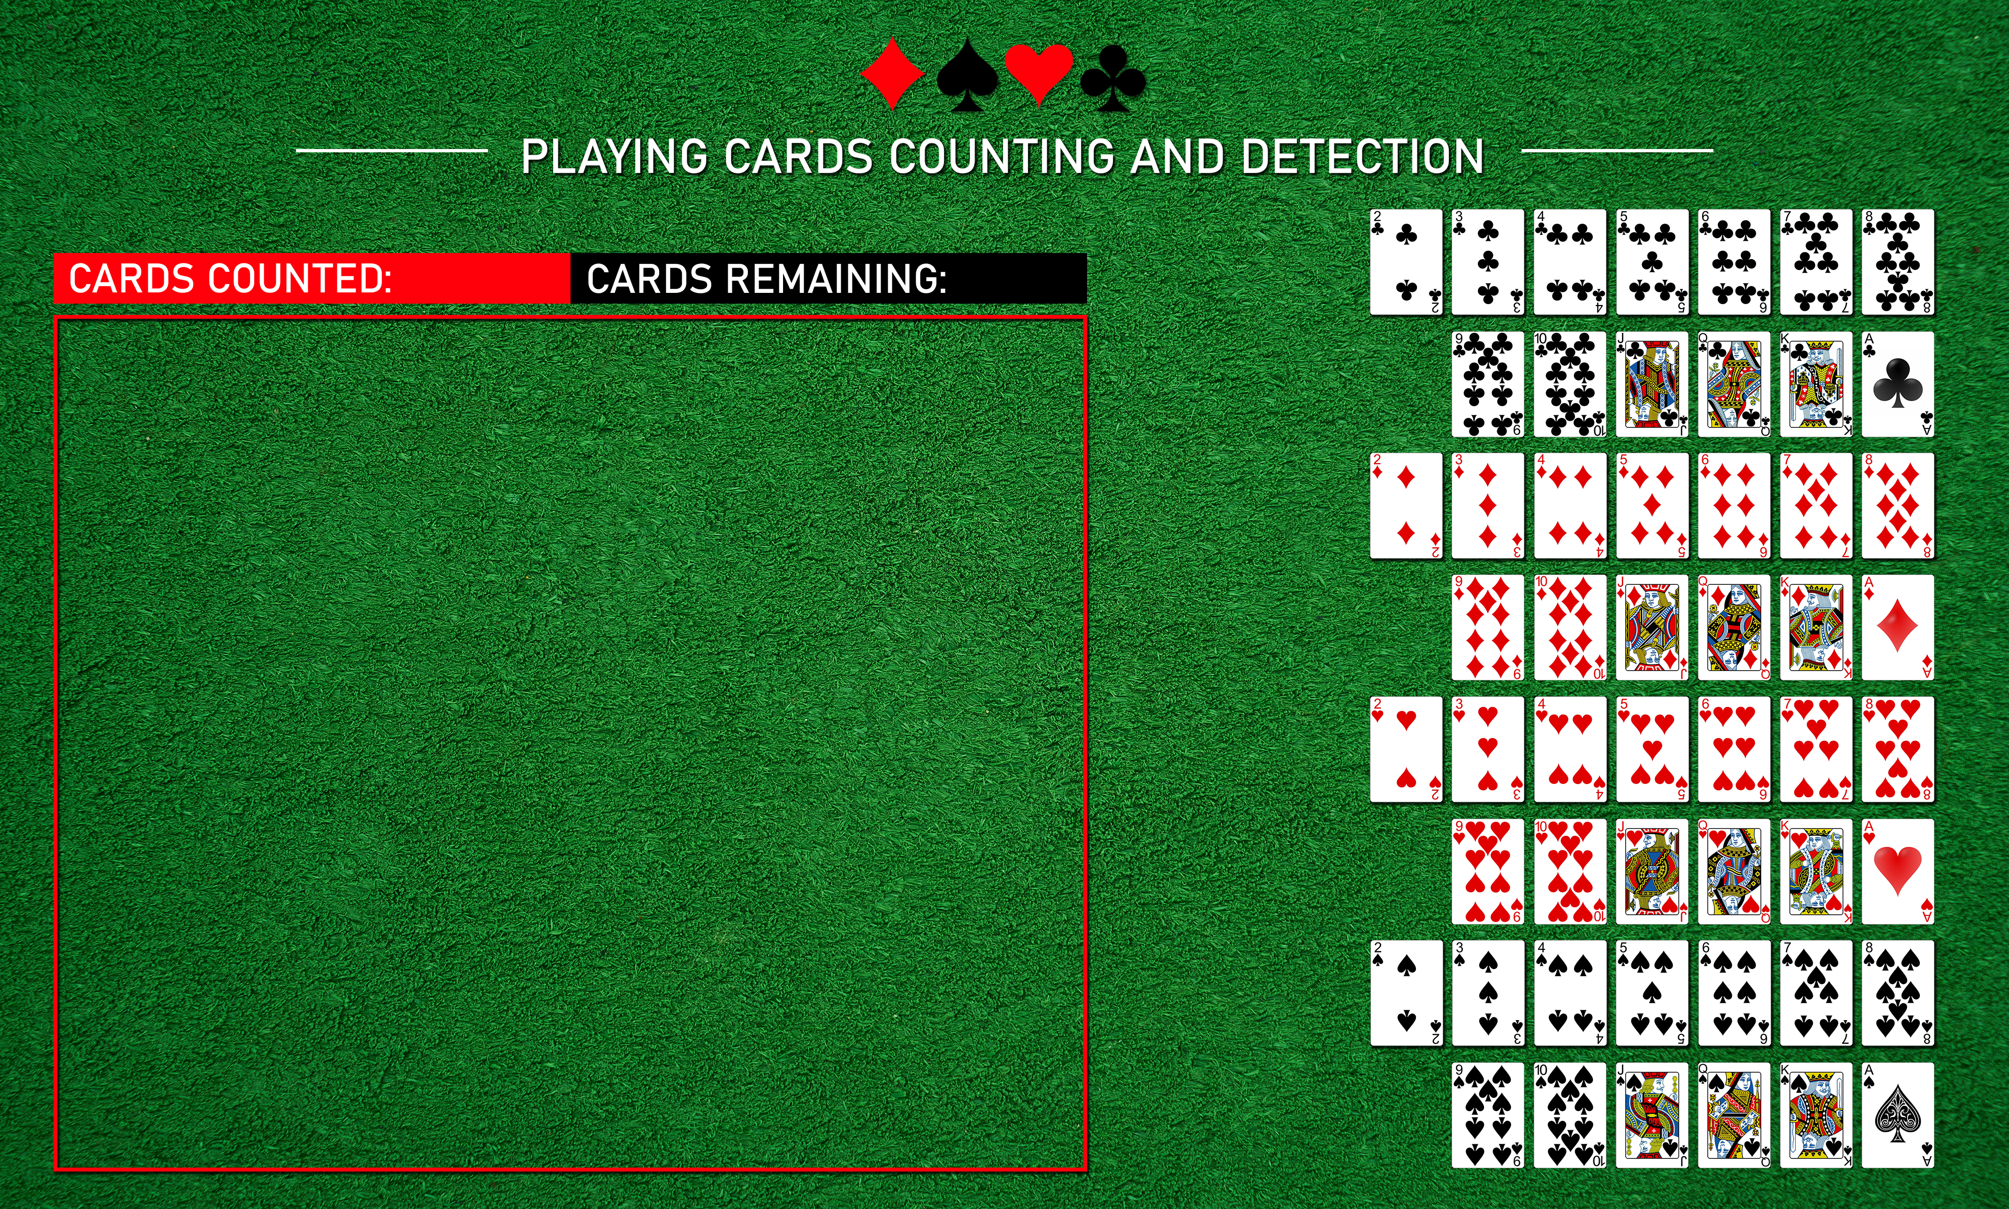
METHODOLOGY
USER INTERFACE
A simple UI with 52 cards
Drawn and remaining card counters
Webcam screen for simultaneous live feed

Slide 10
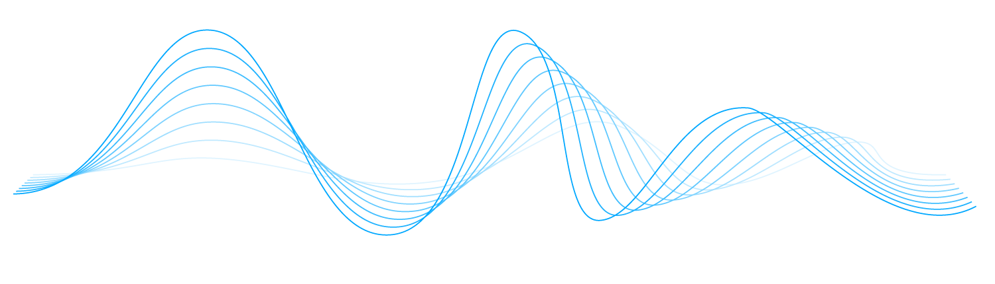
DEMONSTRATION

Slide 11
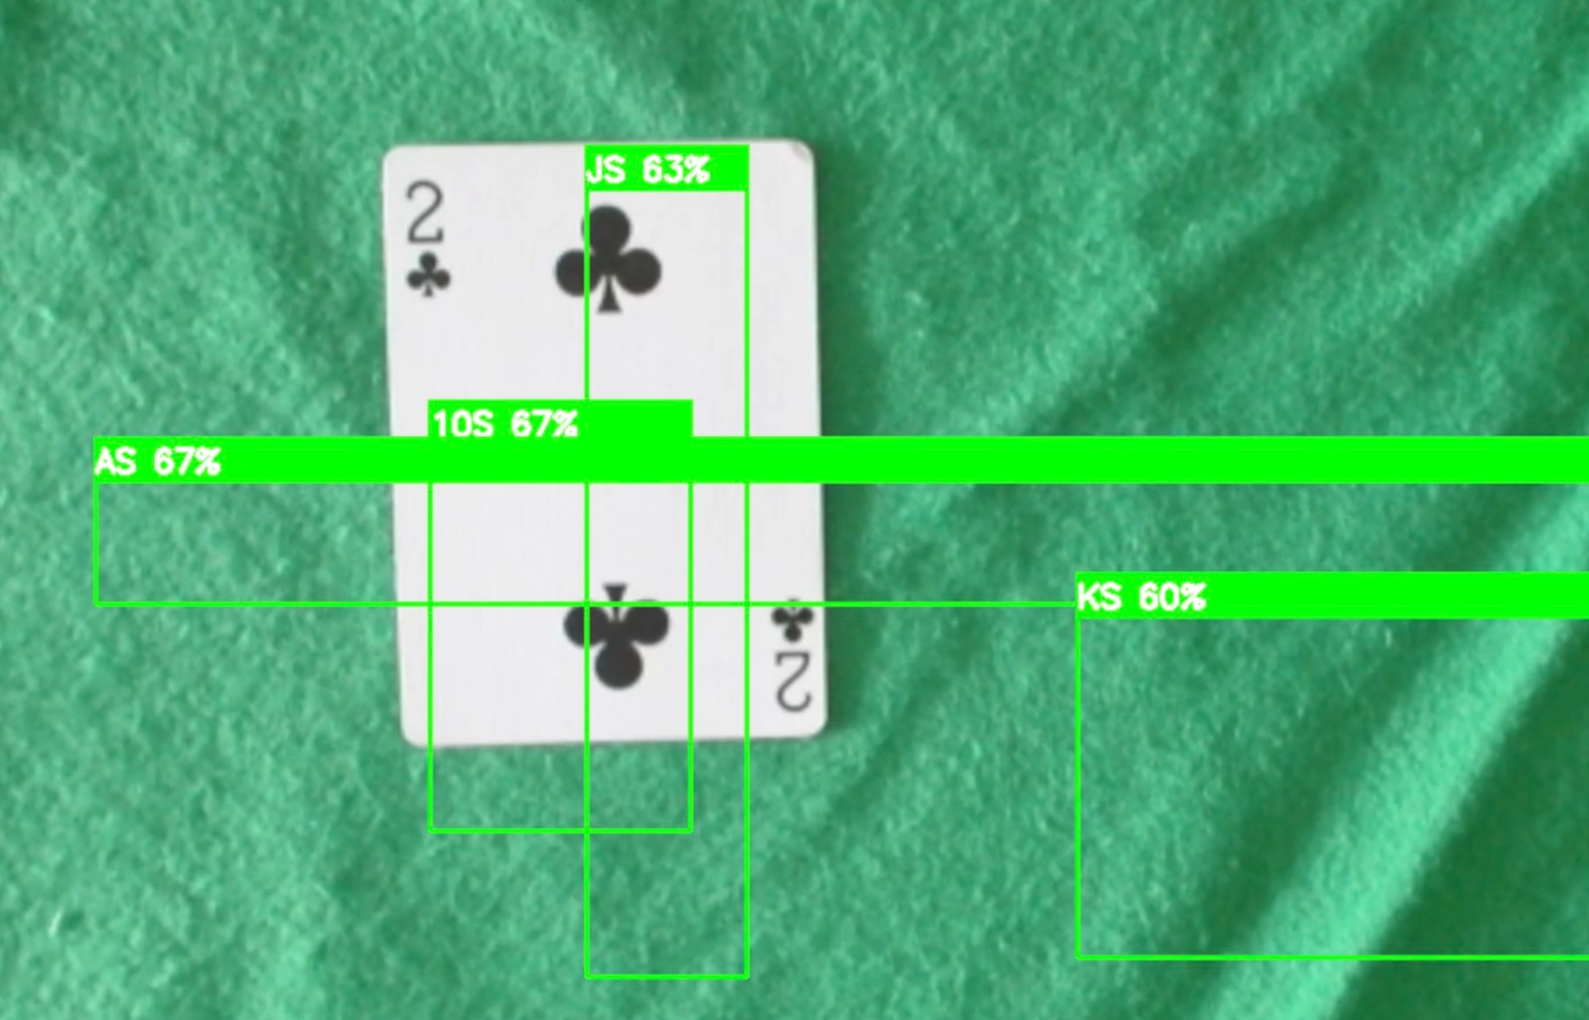
LESSONS LEARNED
Use of Pre-trained Weights
Dataset Challenges
Model Selection Considerations
Hyperparameters Tuning
Real-world Limitations
Computational Resources

Slide 12

THANK YOU
QUESTIONS

